Slide 1

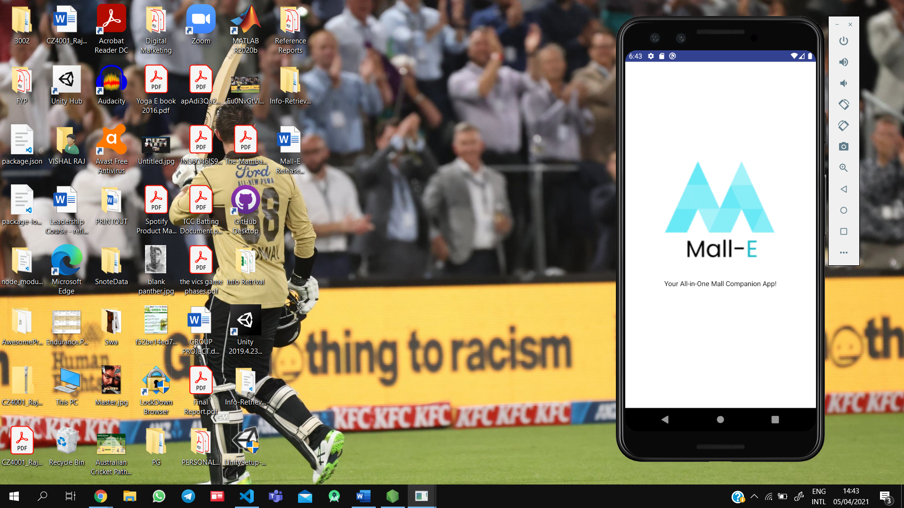
MALL-E
Your All-in-One Mall Companion App!
Developed by Run Time Error

Slide 2
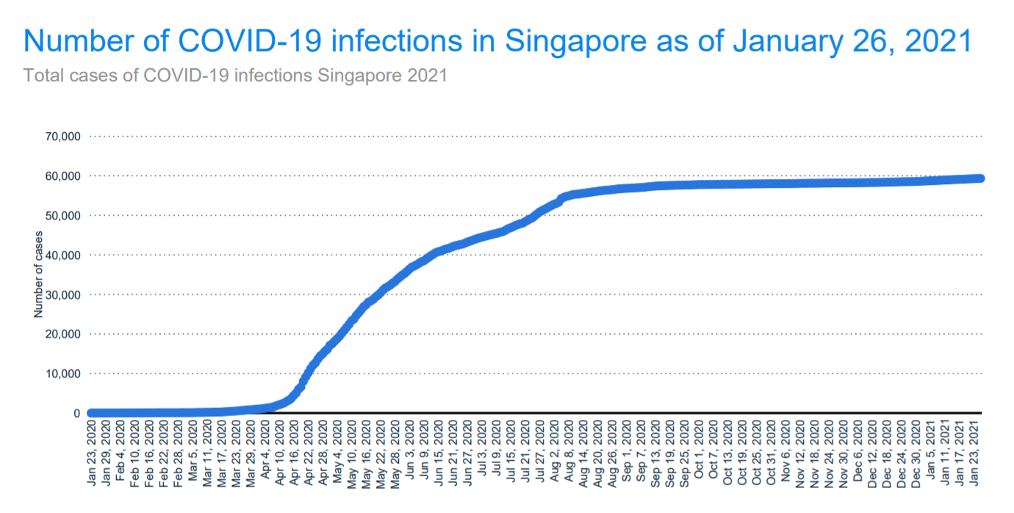
Understanding the Problem
COVID-19 infections in Singapore have plateaued since the start of Phase 3 in December, 2020
Citizens need to be cautious since the lockdown rules have been minified but the virus still remains
People are going out to malls and restaurants but they have to follow MOH’s safe-distancing-measures

Slide 3
OUR SOLUTION
01
02
03
Monitor
CROWD LEVELS
In malls around Singapore
Provides
WAITING TIME
In restaurants of chosen malls
Raise
AWARENESS
Of Covid-19

Slide 4
FUNCTIONAL REQUIREMENTS
01
Check Crowd Density of Malls
Map containing colored markers (based on crowd density) highlighting the malls
Graph of overall crowd density per hour scraped from Best Time API
02
Check Waiting/Queue Times of Restaurants
List of restaurants in that mall, each listing contains the name, cuisine, rating, location, description, and a picture of the restaurant
Data scraped from Google Popular Times API
03
Display News related to COVID in Malls in Singapore
Display the top 5 news articles from Google News related to COVID in Singapore malls
Each article has a headline, a picture, and the first 50 words of the article truncated

Slide 5
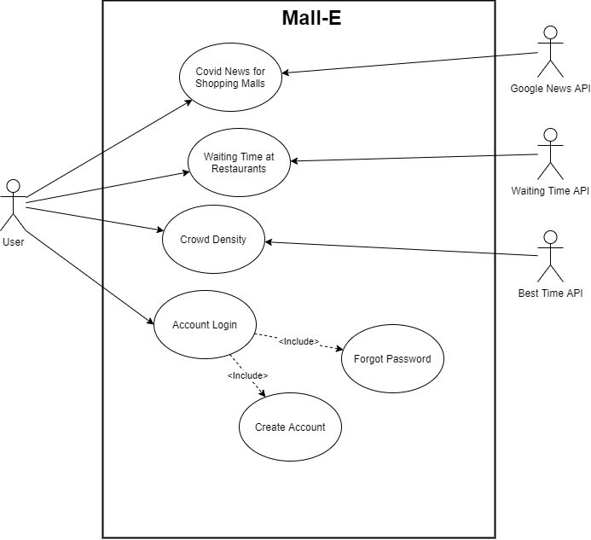
Use Case Diagram & Sequence Diagram

Slide 6
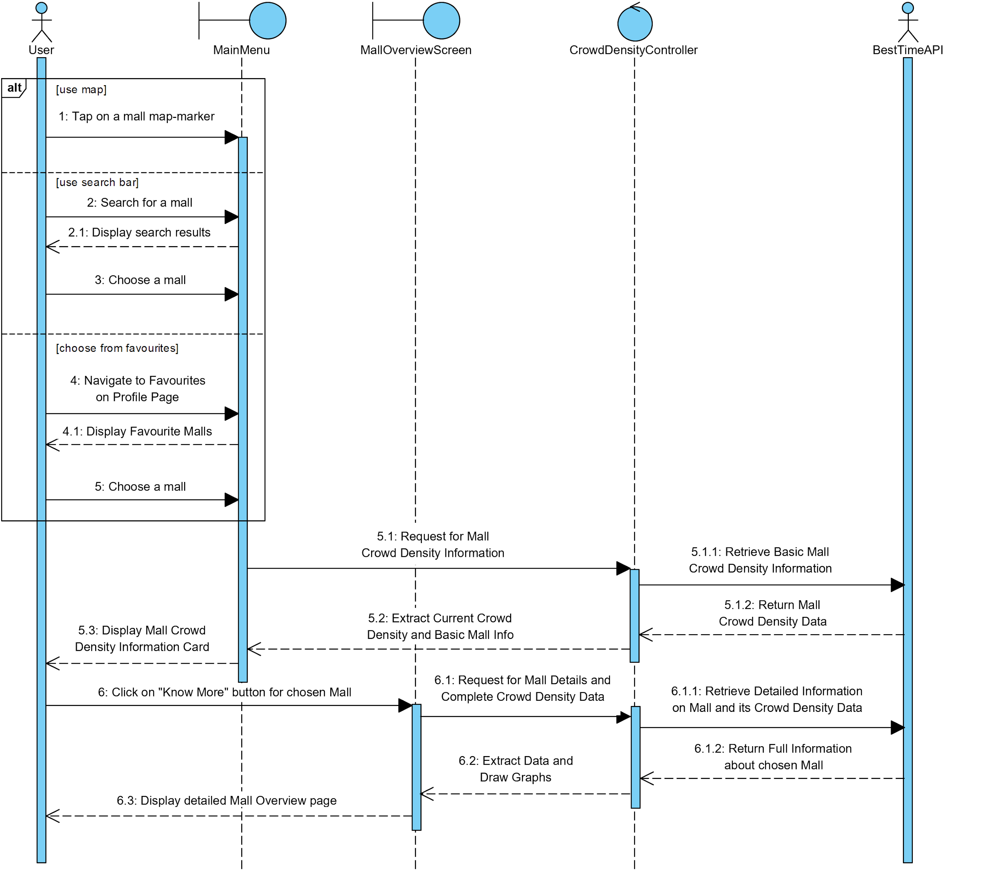

Slide 7
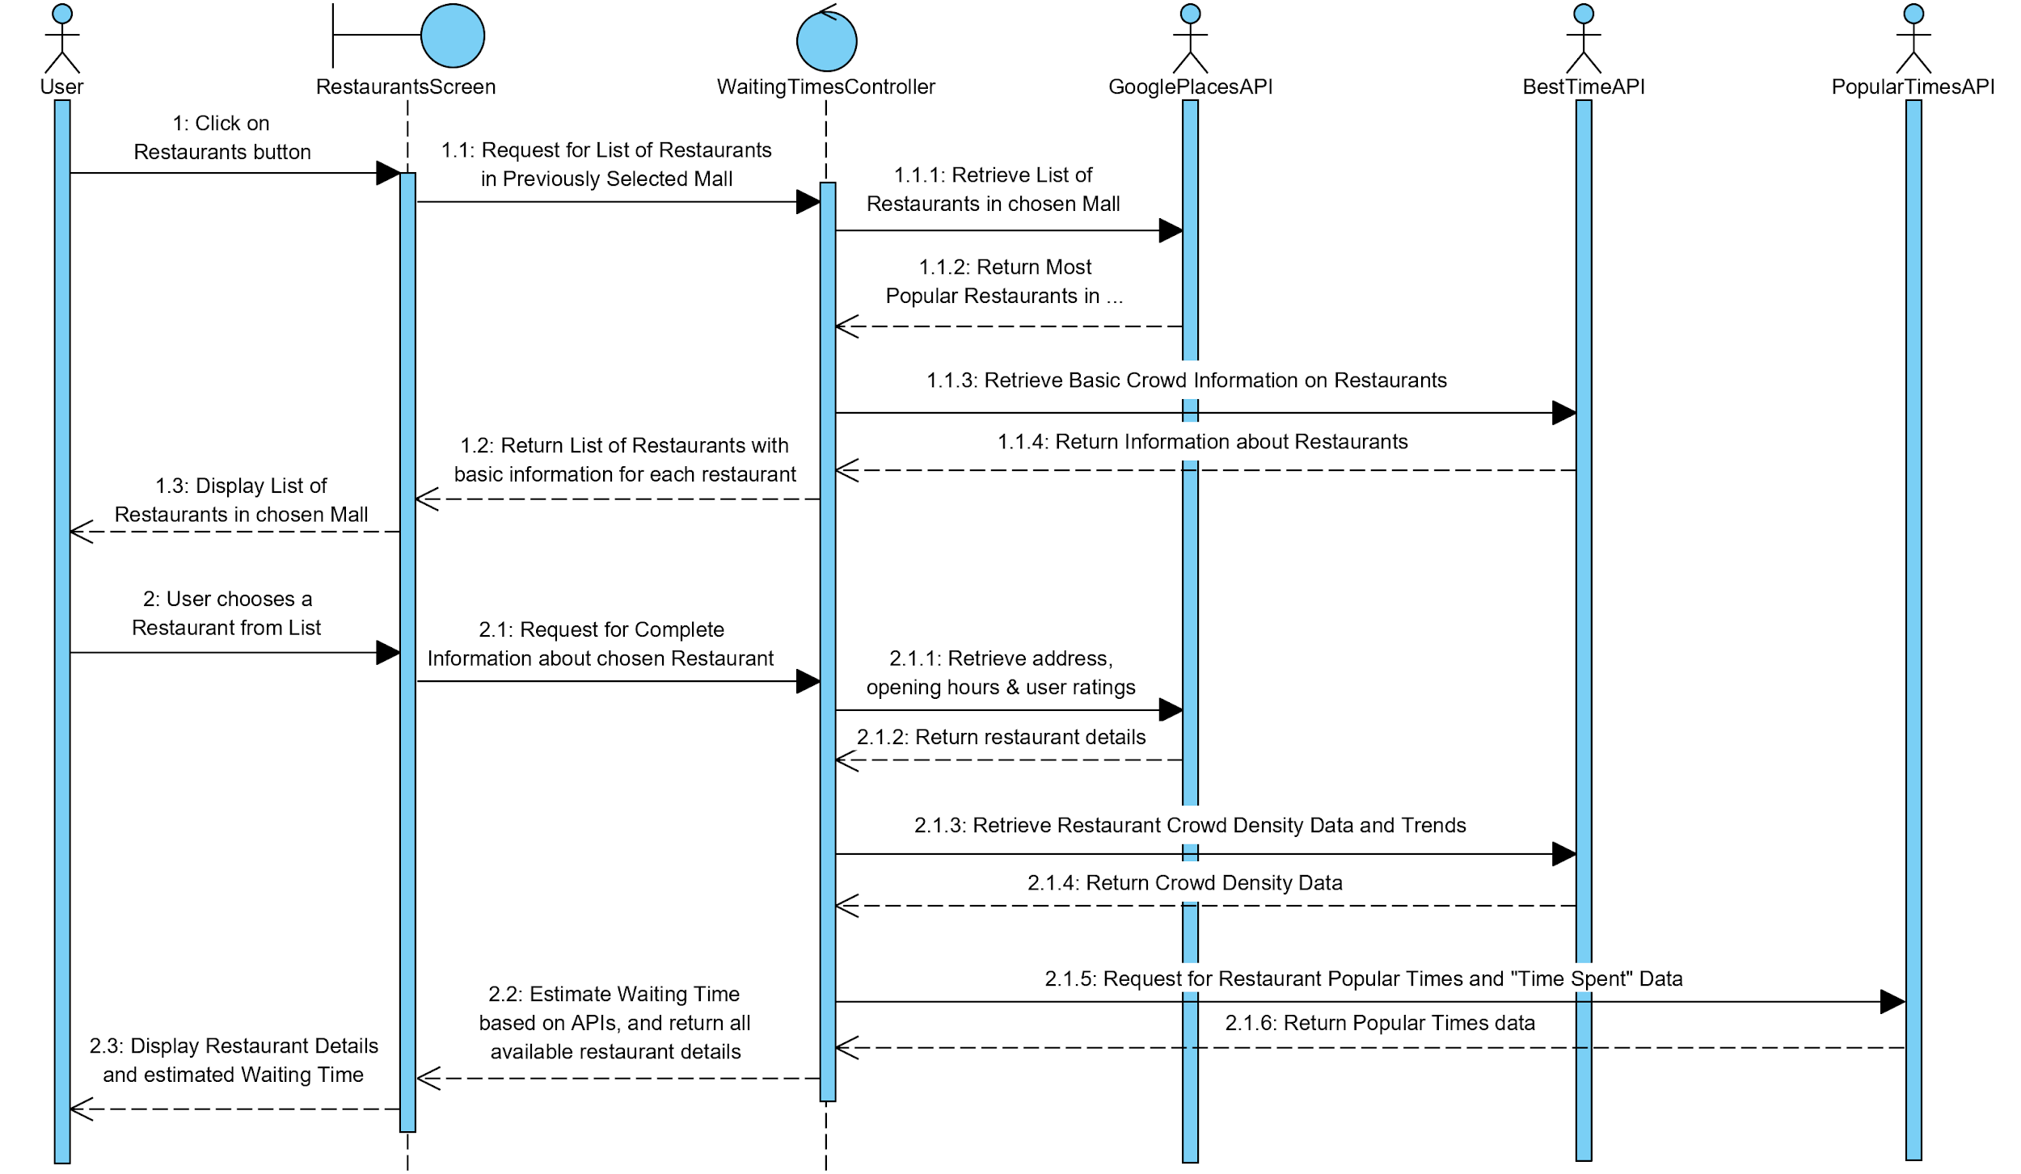

Slide 8
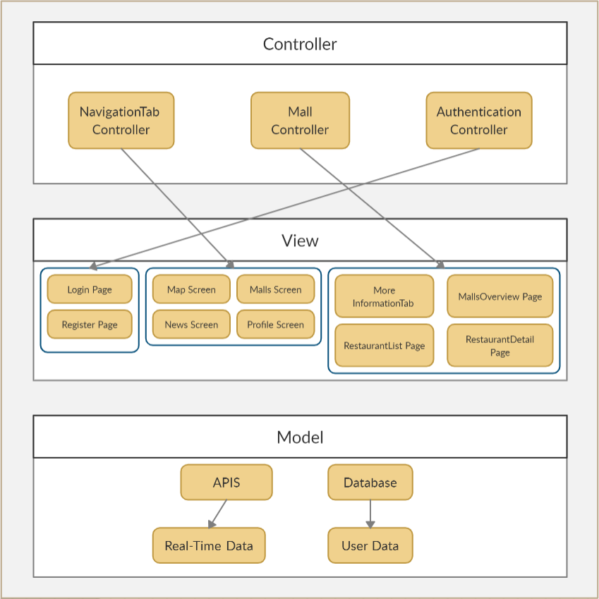
Architectural Diagram

Slide 9



Tech Stack
React Native for the Frontend framework
NodeJS for the Backend framework
MongoDB for the Database

Slide 10
ISSUES ENCOUNTERED
01
04
02
05
03
06
Retrieving data from BestTime API
React Native - Dependency Errors
Usage of non open source APIs
Integration of Python Backend & JavaScript Frontend
Google Maps API - Blank Maps
Merging Code

Slide 11
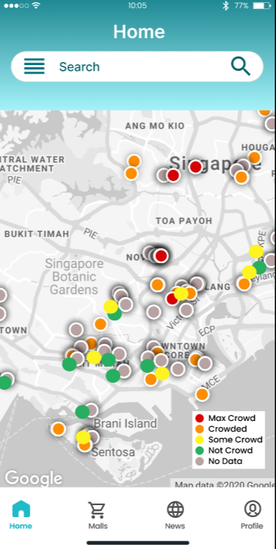
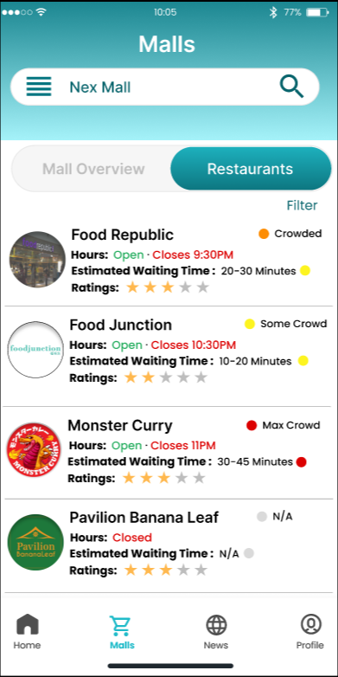
ACHIEVEMENTS
01
02
Meeting the expected UI standard
Usage of Real-Time Data

Slide 12
LAB 1
01
02
03
Brainstorming Ideas with purpose
Importance of Initial Planning
Meeting functional requirements

Slide 13
LAB 2
01
02
Refinement and Development of Initial Idea
Importance of Ideation and Planning phase

Slide 14
LAB 3
01
02
03
Setting Milestones for accomplishment
Delegation of tasks in an efficient way to meet the estimated development phase
Analysing the potential risks involved and risk mitigation strategies

Slide 15
LAB 4
01
02
03
04
Ensuring version control for the entire program
Maintainability of the application (Single Responsibility)
Updating teams members about progress and potential changes
Releasing the application successfully

Slide 16
LIVE DEMO

